Slide 1
Deep Reinforcement Learning for Automated Stock Trading Ensemble Strategy

Slide 2
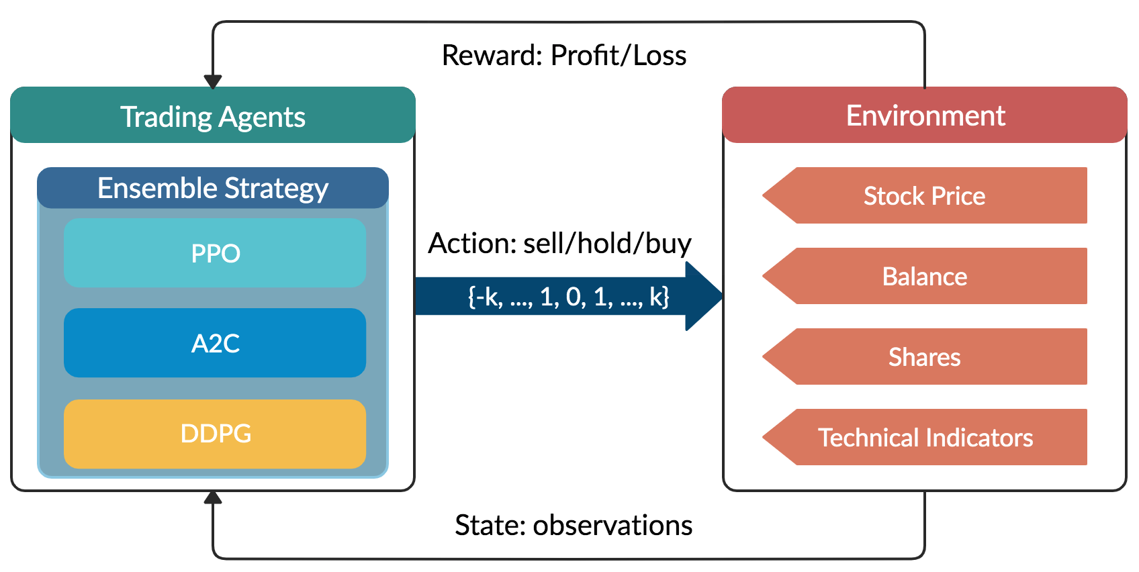
Introduction
The ensemble strategy inherits and integrates the best features of the three algorithms, thereby robustly adjusting to different market situations and using a load on demand technique for processing large data to avoid large memory consumption.
Trading agents and environments interacts with each other using Action, State and Reward

Slide 3
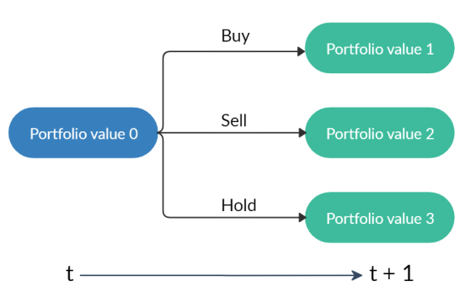
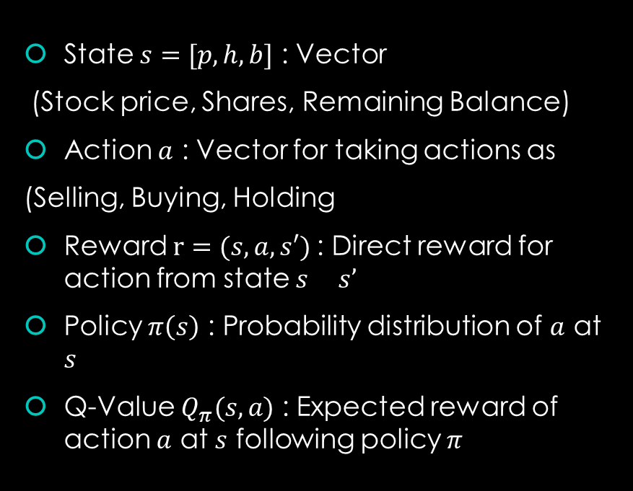
Markov Decision Process for Stock Trading
State $s=[p,h,b]$ : Vector
(Stock price, Shares, Remaining Balance)
Action $a$ : Vector for taking actions as
(Selling, Buying, Holding
Reward $r=(s, a,s′)$: Direct reward for action from state $s s’$
Policy $π\left(s\right)$ : Probability distribution of $a$ at $s$
Q-Value $Q_{π}(s,a)$ : Expected reward of action $a$ at $s$ following policy $π$
Taking action will change Portfolio

Slide 4
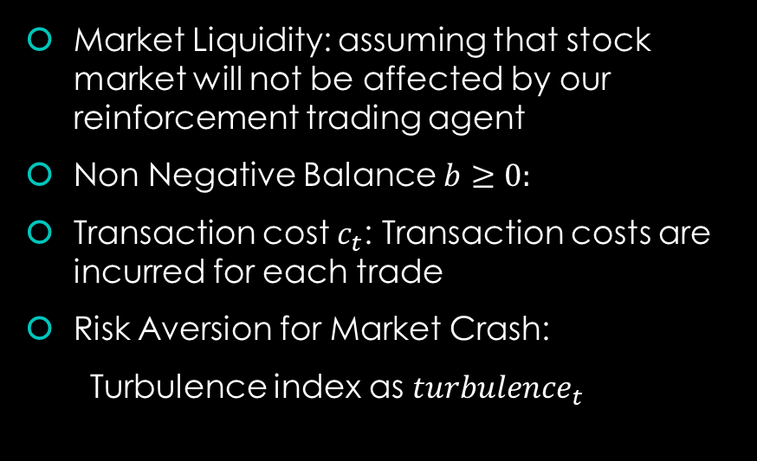
Return Maximization as Trading Goal
Stocking Constraints
Market Liquidity: assuming that stock market will not be affected by our reinforcement trading agent
Non Negative Balance $b≥0:$
Transaction cost $c_{t}$: Transaction costs are incurred for each trade
Risk Aversion for Market Crash:
Turbulence index as ${turbulence}_{t}$
Maximising Reward Function
$r= {Potfolio}_{t+1}−{portfolio}_{t}−c_{t}$
𝑟= 〖𝑃𝑜𝑡𝑓𝑜𝑙𝑖𝑜〗_(𝑡+1)−〖𝑝𝑜𝑟𝑡𝑓𝑜𝑙𝑖𝑜〗_𝑡−𝑐_𝑡
Sell all during Market Crash
${turbulence}_{t}$ > threshold value
〖𝑡𝑢𝑟𝑏𝑢𝑙𝑒𝑛𝑐𝑒〗_𝑡 > threshold value

Slide 5
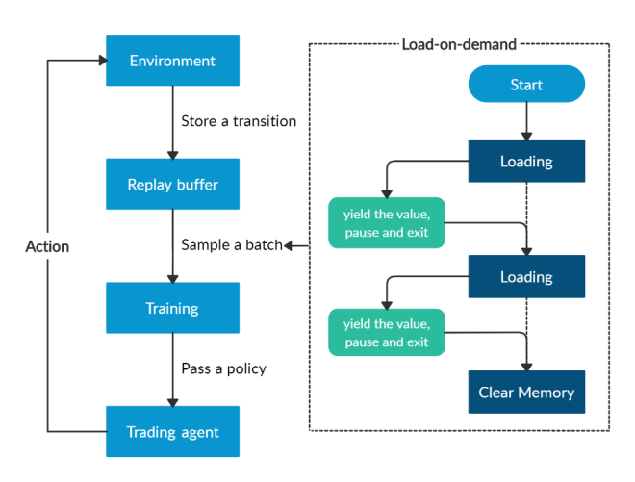
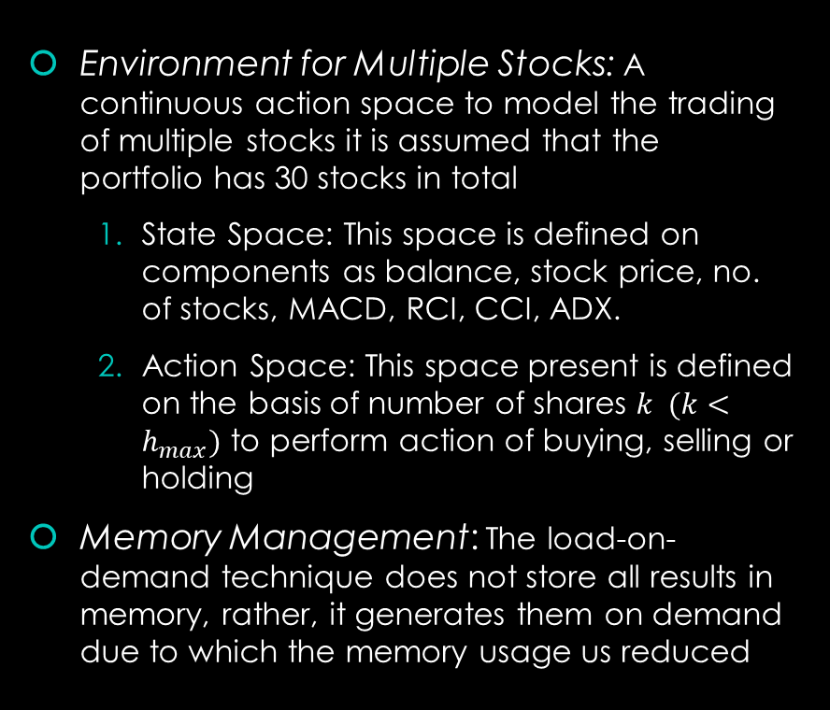
Stock Trading management
Environment for Multiple Stocks: A continuous action space to model the trading of multiple stocks it is assumed that the portfolio has 30 stocks in total
State Space: This space is defined on components as balance, stock price, no. of stocks, MACD, RCI, CCI, ADX.
Action Space: This space present is defined on the basis of number of shares $k (k<h_{max})$ to perform action of buying, selling or holding
Memory Management: The load-on-demand technique does not store all results in memory, rather, it generates them on demand due to which the memory usage us reduced

Slide 6
Deep Learning Algorithms
Advantage Actor Critic (A2C)
It is a typical actor-critic algorithm which utilizes an advantage function to reduce the variance of the policy gradient.
It is a great model for stock trading because of its stability.
Proximal Policy Optimization (PPO)
It updates and ensure that the new policy will not be too different from the previous one.
Chosen for stock trading because it is stable, fast, and simpler to implement and tune.
Deep Deterministic Policy Gradient (DDPG)
It encourage maximum investment return and combines the frameworks of both Q-learning and policy gradient.
It is effective at handling continuous action space, and so it is appropriate for stock trading.

Slide 7
Ensemble Strategy
Step 1
Growing window of n months to retrain our three agents concurrently, for the paper n=3
Step 2
Calculating Sharpe Ratio
$Sharpe ratio= \frac{\overline{r_{p}}−r_{f}}{σ_{p}}$ ${\overline{r}}_{p}$- portfolio return, $r_{f}$- risk free return, $σ_{p}$- portfolio standard deviation
𝑆ℎ𝑎𝑟𝑝𝑒 𝑟𝑎𝑡𝑖𝑜= ((𝑟_𝑝 ) ̅−𝑟_𝑓)/𝜎_𝑝 𝑟 ̅_𝑝- portfolio return, 𝑟_𝑓- risk free return, 𝜎_𝑝﷮- portfolio standard deviation
Step 3
After the best agent is picked, it is used to predict and trade for the next quarter.
This maximizes the returns adjusted to the increasing risk

Slide 8
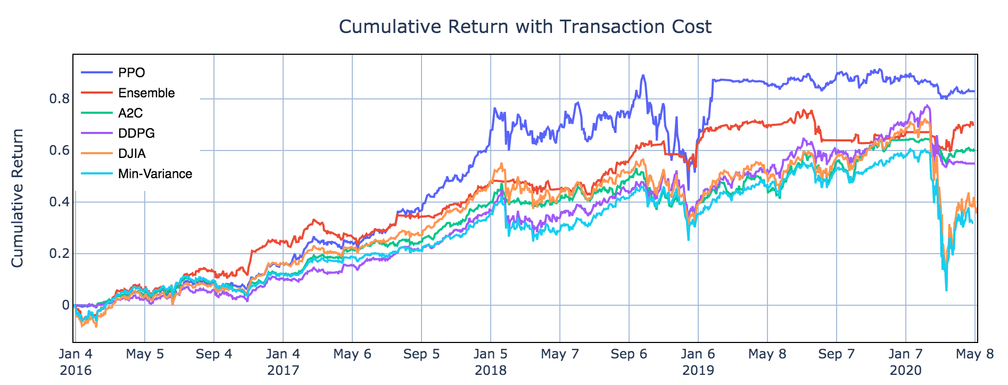
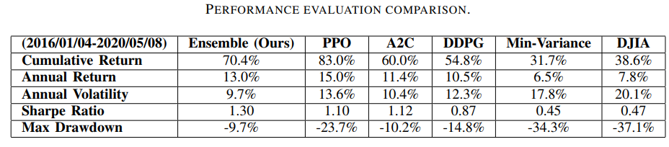
Performance Evaluation Plots

Slide 9
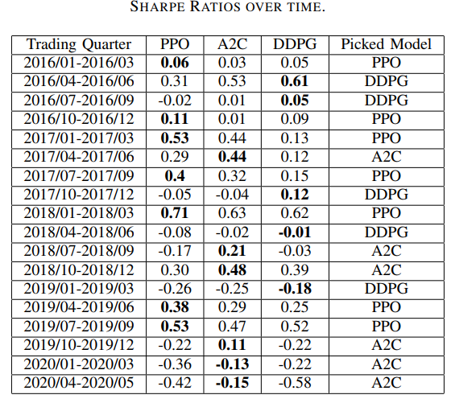
Performance Evaluation Conclusions
A2C agent is more adaptive to risk. It has the lowest annual volatility 10.4% and max drawdown -10.2%
PPO agent is good at following trend and acts well in generating more returns, it has the highest annual return 15.0% and cumulative return 83.0%
DDPG performs similar but not as good as PPO, it can be used as a complementary strategy to PPO, but its returns are not as satisfactory as other two.
By incorporating the turbulence index, the agents are able to cut losses and successfully survive the stock market crash in March 2020.

Slide 10
Results for Ensemble Strategy
The ensemble strategy achieves a Sharpe ratio 1.30, which is much higher than the Sharpe ratio the two baselines, 0.47 for DJIA, and 0.45 for the min-variance portfolio allocation
The ensemble strategy also outperforms A2C with a Sharpe ratio of 1.12, PPO with a Sharpe ratio of 1.10, and DDPG with a Sharpe ratio of 0.87, respectively
Ensemble strategy outperforms the three individual algorithms, balancing risk and return under transaction costs, which makes it auto adjustable to choose for the specific market condition.

Slide 11
References
Deep Reinforcement Learning for Automated Stock Trading: An Ensemble Strategy
A2C Algorithm
Proximity Policy Optimization Algorithm
Deep Deterministic Policy Gradient algorithm

